Slide 1
Mathematical Foundations for Data Science
MFDS Team

Slide 2
DSECL ZC416, MFDS
Lecture No. 12

Slide 3
Agenda
Recursively Defined Functions
Recursively Defined Sets and Structures
Structural Induction
Generalized Induction

Slide 4
Recursively Defined Functions
Definition: A recursive or inductive definition of a function consists of two steps.
  BASIS STEP: Specify the value of the function at zero.
  RECURSIVE STEP: Give a rule for finding its value at an integer from its values at smaller integers.
A function f(n) is the same as a sequence a₀, a₁, … , where a_{i}, where f(i) = a_{i}.

Slide 5
Recursively Defined Functions
Example: Suppose f is defined by:
f(0) = 3,
f(n + 1) = 2f(n) + 3
Find f(1), f(2), f(3), f(4)
Solution:
    f(1) = 2f(0) + 3 = 2∙3 + 3 = 9
    f(2) = 2f(1)+ 3 = 2∙9 + 3 = 21
    f(3) = 2f(2) + 3 = 2∙21 + 3 = 45
    f(4) = 2f(3) + 3 = 2∙45 + 3 = 93
Example: Give a recursive definition of the factorial function n!:
Solution:
  f(0) = 1
  f(n + 1) = (n + 1)∙ f(n)

Slide 6
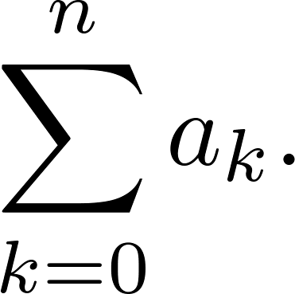
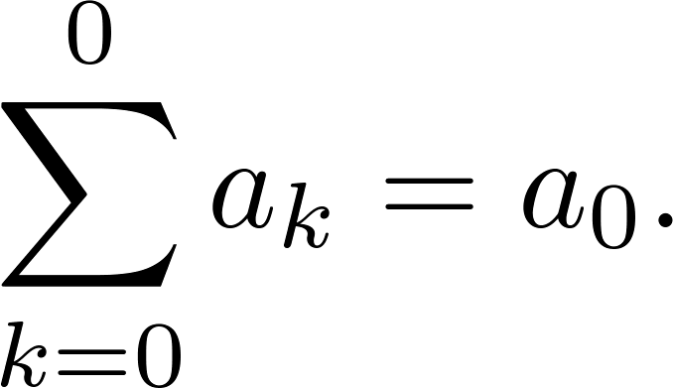
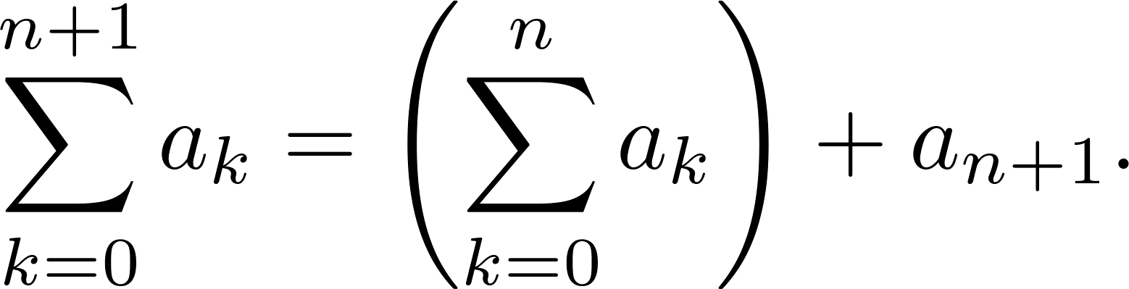
Recursively Defined Functions
Example: Give a recursive definition of:
Solution: The first part of the definition is
The second part is

Slide 7
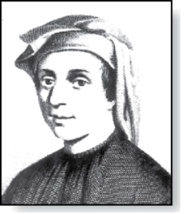
Fibonacci Numbers
Example : The Fibonacci numbers are defined as follows:
  f₀ = 0
  f₁ = 1
  f_{n} = f_{n−1} + f_{n−2}
Find f₂, f₃ , f₄ , f₅ .
    f₂ = f₁ + f₀ = 1 + 0 = 1
    f₃ = f₂ + f₁ = 1 + 1 = 2
    f₄ = f₃ + f₂ = 2 + 1 = 3
    f₅ = f₄ + f₃ = 3 + 2 = 5
Fibonacci
(1170- 1250)

Slide 8
Fibonacci Numbers
Example 4: Show that whenever n ≥ 3, f_{n} > α^{n − 2}, where α = (1 + √5)/2.
Solution: Let P(n) be the statement f_{n} > α^{n−2} . Use strong induction to show that P(n) is true whenever n ≥ 3.
  BASIS STEP: P(3) holds since α < 2 = f₃
  P(4) holds since α² = (3 + √5)/2 < 3 = f₄ .
  INDUCTIVE STEP: Assume that P(j) holds, i.e., f_{j} > α^{j−2} for all integers j with
  3 ≤ j ≤ k, where k ≥ 4. Show that P(k + 1) holds, i.e., f_{k+1} > α^{k−1} .
    Since α² = α + 1 (because α is a solution of x² − x − 1 = 0),
    By the inductive hypothesis, because k ≥ 4 we have
    Therefore, it follows that
    Hence, P(k + 1) is true.
α^{k−1} = α² ∙ α^{k−3} = ( α + 1) ∙α^{k−3} = α ∙α^{k−3}+ 1 ∙α^{k−3} = α^{k−2} + α^{k−3}
f_{k−1} > α^{k−3}, f_{k} > α^{k−2}.
Why does this equality hold?
f_{k+1} = f_{k} + f_{k−1} > α^{k−2} + α^{k−3} = α^{k−1}.

Slide 9
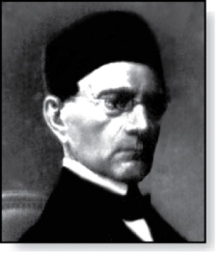
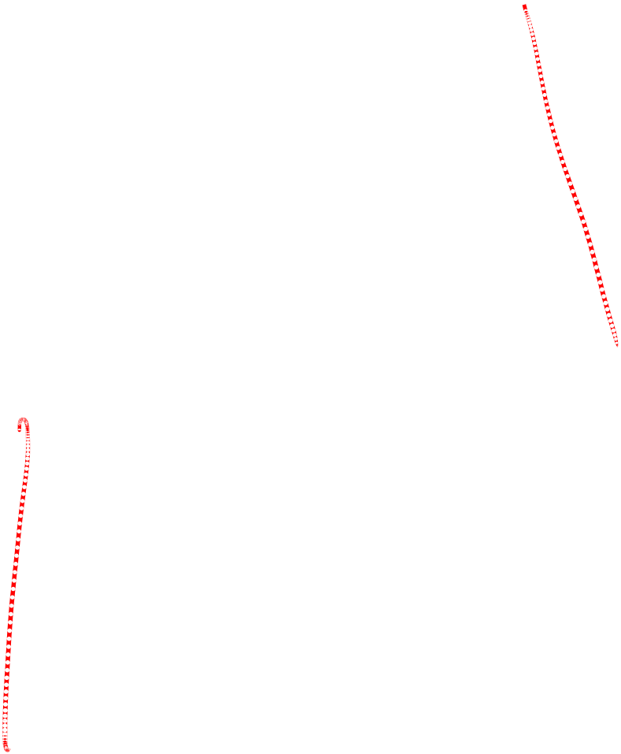
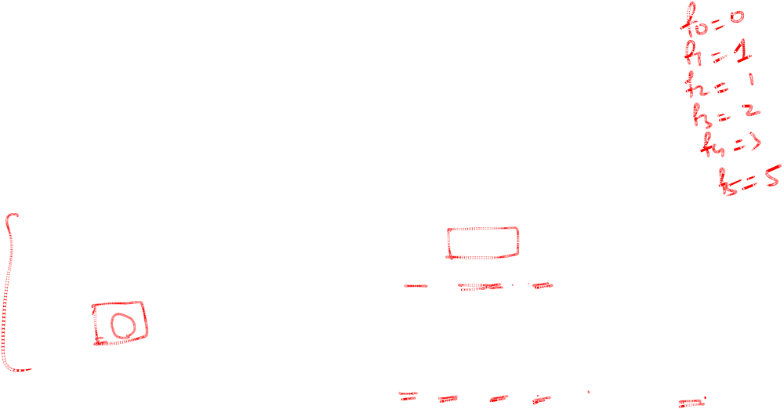
Lamé’s Theorem
Gabriel Lamé
(1795-1870)
Lamé’s Theorem: Let a and b be positive integers with a ≥ b. Then the number of divisions used by the Euclidian algorithm to find gcd(a,b) is less than or equal to five times the number of decimal digits in b.
Proof: When we use the Euclidian algorithm to find gcd(a,b) with a ≥ b,
n divisions are used to obtain (with a = r₀,b =r₁ ):
Since each quotient q₁, q₂ , …,q_{n-1} is at least 1 and q_{n} ≥ 2:
r₀ = r₁q₁ + r₂ 0 ≤ r₂ < r₁,
r₁ = r₂q₂ + r₃ 0 ≤ r₃ < r₂,
⋮
r_{n-2} = r_{n-1}q_{n-1} + r_{n} 0 ≤ r_{n} < r_{n-1},
r_{n-1} = r_{n}q_{n}.
  r_{n} ≥ 1 = f₂,
  r_{n-1} ≥ 2 r_{n} ≥ 2 f₂ = f₃,
  r_{n-2} ≥ r_{n-1} + r_{n} ≥ f₃ + f₂ = f₄,
  ⋮
  r₂ ≥ r₃ + r₄ ≥ f_{n-1} + f_{n-2} = f_{n},
  b = r₁ ≥ r₂ + r₃ ≥ f_{n} + f_{n-1} = f_{n+1}.

Slide 10
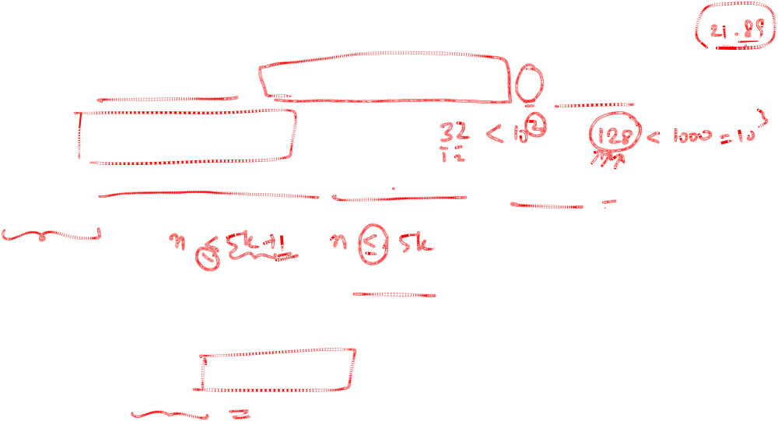
Lamé’s Theorem
It follows that if n divisions are used by the Euclidian algorithm to find gcd(a,b) with a ≥ b, then b ≥ f_{n+1}. By Example 4, f_{n+1} > α^{n − 1}, for n > 2, where α = (1 + √5)/2. Therefore, b > α^{n−1}.
Because log₁₀ α ≈ 0.208 > 1/5, log₁₀ b > (n−1) log₁₀ α > (n−1)/5 . Hence,
Suppose that b has k decimal digits. Then b < 10^{k} and log₁₀ b < k. It follows that n − 1 < 5k and since k is an integer, n ≤ 5k.
As a consequence of Lamé’s Theorem, O(log b) divisions are used by the Euclidian algorithm to find gcd(a,b) whenever a > b.
  By Lamé’s Theorem, the number of divisions needed to find gcd(a,b) with a > b is less than or equal to 5 (log₁₀ b + 1) since the number of decimal digits in b (which equals ⌊log₁₀ b⌋ + 1) is less than or equal to log₁₀ b + 1.
n−1 < 5 ∙log₁₀ b.
Lamé’s Theorem was the first result in computational complexity

Slide 11
Recursively Defined Sets and Structures
Recursive definitions of sets have two parts:
  The basis step specifies an initial collection of elements.
  The recursive step gives the rules for forming new elements in the set from those already known to be in the set.
Sometimes the recursive definition has an exclusion rule, which specifies that the set contains nothing other than those elements specified in the basis step and generated by applications of the rules in the recursive step.
We will always assume that the exclusion rule holds, even if it is not explicitly mentioned.
We will later develop a form of induction, called structural induction, to prove results about recursively defined sets.

Slide 12
Recursively Defined Sets and Structures
Example : Subset of Integers S:
  BASIS STEP: 3 ∊ S.
  RECURSIVE STEP: If x ∊ S and y ∊ S, then x + y is in S.
Initially 3 is in S, then 3 + 3 = 6, then 3 + 6 = 9, etc.
Example: The natural numbers N.
  BASIS STEP: 0 ∊ N.
  RECURSIVE STEP: If n is in N, then n + 1 is in N.
Initially 0 is in S, then 0 + 1 = 1, then 1 + 1 = 2, etc.

Slide 13
Strings
Definition: The set Σ* of strings over the alphabet Σ:
  BASIS STEP: λ ∊ Σ* (λ is the empty string)
  RECURSIVE STEP: If w is in Σ* and x is in Σ, then wx ∈ Σ*.
Example: If Σ = {0,1}, the strings in in Σ* are the set of all bit strings, λ,0,1, 00,01,10, 11, etc.
Example: If Σ = {a,b}, show that aab is in Σ*.
  Since λ ∊ Σ* and a ∊ Σ, a ∊ Σ*.
  Since a ∊ Σ* and a ∊ Σ, aa ∊ Σ*.
  Since aa ∊ Σ* and b ∊ Σ, aab ∊ Σ*.

Slide 14

String Concatenation
Definition: Two strings can be combined via the operation of concatenation. Let Σ be a set of symbols and Σ* be the set of strings formed from the symbols in Σ. We can define the concatenation of two strings, denoted by ∙, recursively as follows.
  BASIS STEP: If w ∈ Σ*, then w ∙ λ= w.
  RECURSIVE STEP: If w₁ ∈ Σ* and w₂ ∈ Σ* and x ∈ Σ, then w₁ ∙ (w₂ x)= (w₁ ∙ w₂)x.
Often w₁ ∙ w₂ is written as w₁ w₂.
If w₁ = abra and w₂ = cadabra, the concatenation w₁ w₂ = abracadabra.

Slide 15
Length of a String
Example: Give a recursive definition of l(w), the length of the string w.
Solution: The length of a string can be recursively defined by:
  l(λ) = 0;
  l(wx) = l(w) + 1 if w ∊ Σ* and x ∊ Σ.

Slide 16
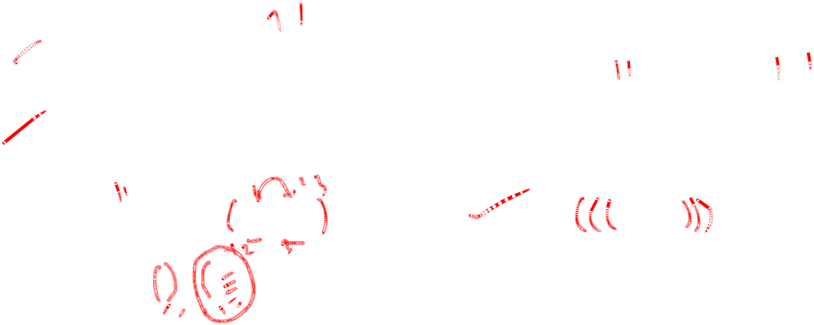
Balanced Parentheses
Example: Give a recursive definition of the set of balanced parentheses P.
Solution:
  BASIS STEP: () ∊ P
  RECURSIVE STEP: If w ∊ P, then () w ∊ P, (w) ∊ P and w () ∊ P.
Show that (() ()) is in P.
Why is ))(() not in P?

Slide 17
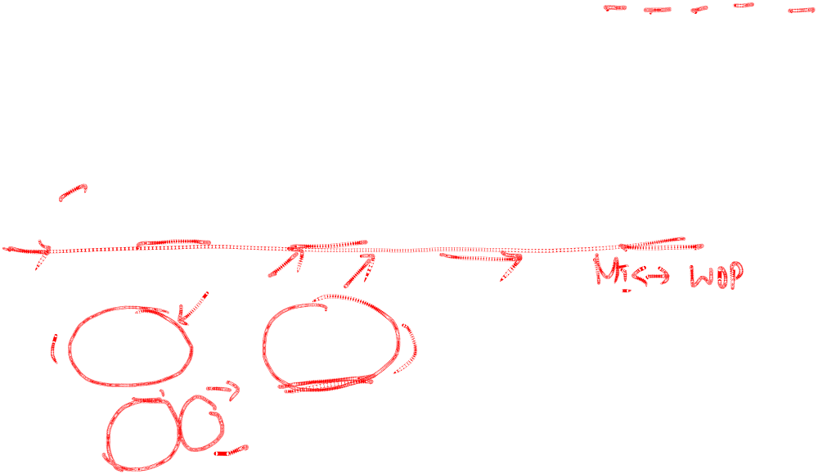
Well-Formed Formulae in Propositional Logic
Definition: The set of well-formed formulae in propositional logic involving T, F, propositional variables, and operators from the set {¬,∧,∨,→,↔}.
  BASIS STEP: T,F, and s, where s is a propositional variable, are well-formed formulae.
  RECURSIVE STEP: If E and F are well formed formulae, then (¬ E), (E ∧ F), (E ∨ F), (E → F), (E ↔ F), are well-formed formulae.
Examples: ((p ∨q) → (q ∧ F)) is a well-formed formula.
pq ∧ is not a well formed formula.

Slide 18
Rooted Trees
Definition: The set of rooted trees, where a rooted tree consists of a set of vertices containing a distinguished vertex called the root, and edges connecting these vertices, can be defined recursively by these steps:
  BASIS STEP: A single vertex r is a rooted tree.
  RECURSIVE STEP: Suppose that T₁, T₂, …,T_{n} are disjoint rooted trees with roots r₁, r₂,…,r_{n}, respectively. Then the graph formed by starting with a root r, which is not in any of the rooted trees T₁, T₂, …,T_{n}, and adding an edge from r to each of the vertices r₁, r₂,…,r_{n}, is also a rooted tree.

Slide 19
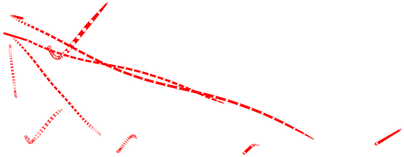
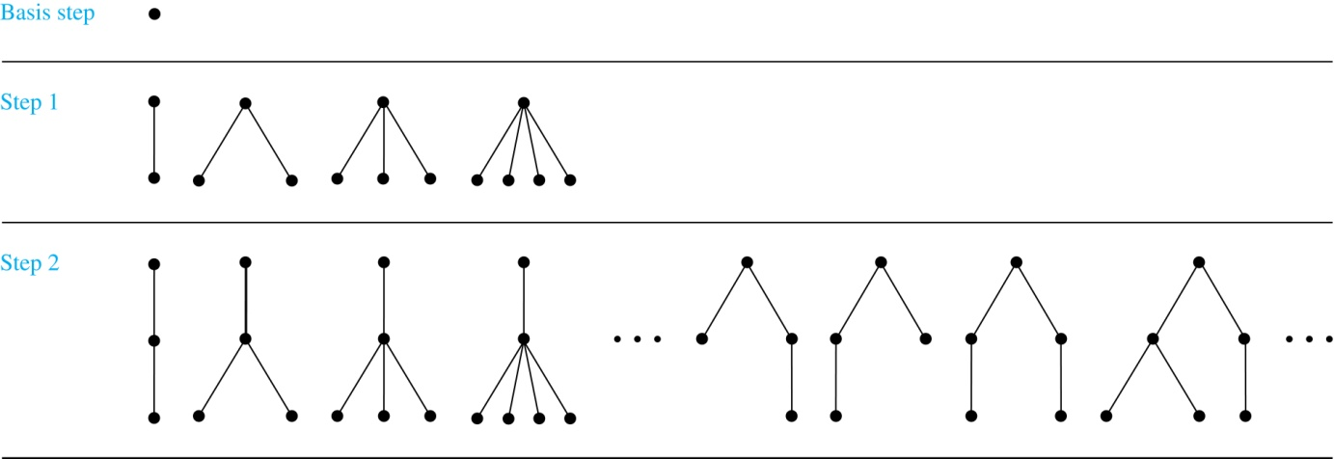
Building Up Rooted Trees

Slide 20
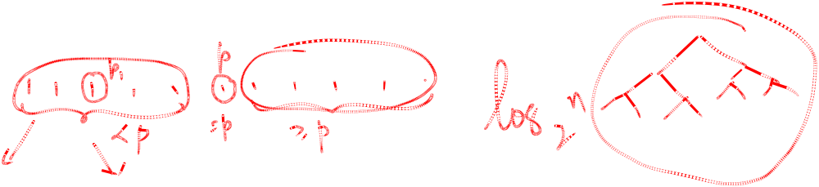
Full Binary Trees
Definition: The set of full binary trees can be defined recursively by these steps.
  BASIS STEP: There is a full binary tree consisting of only a single vertex r.
  RECURSIVE STEP: If T₁ and T₂ are disjoint full binary trees, there is a full binary tree, denoted by T₁∙T₂, consisting of a root r together with edges connecting the root to each of the roots of the left subtree T₁ and the right subtree T₂.

Slide 21
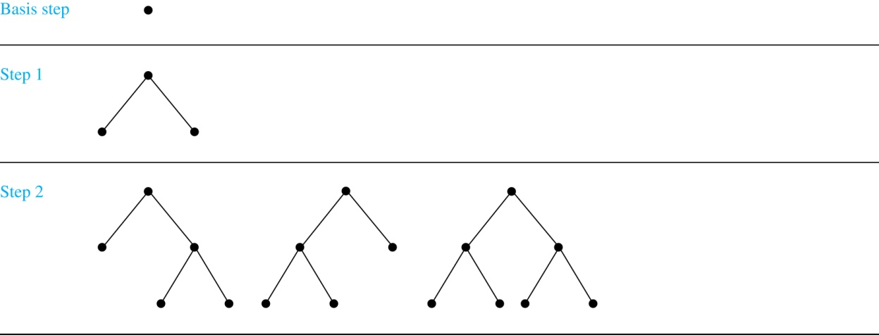
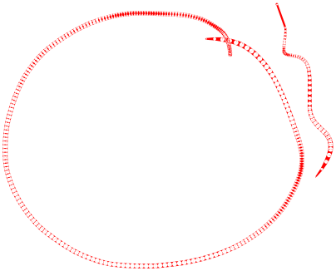
Building Up Full Binary Trees

Slide 22
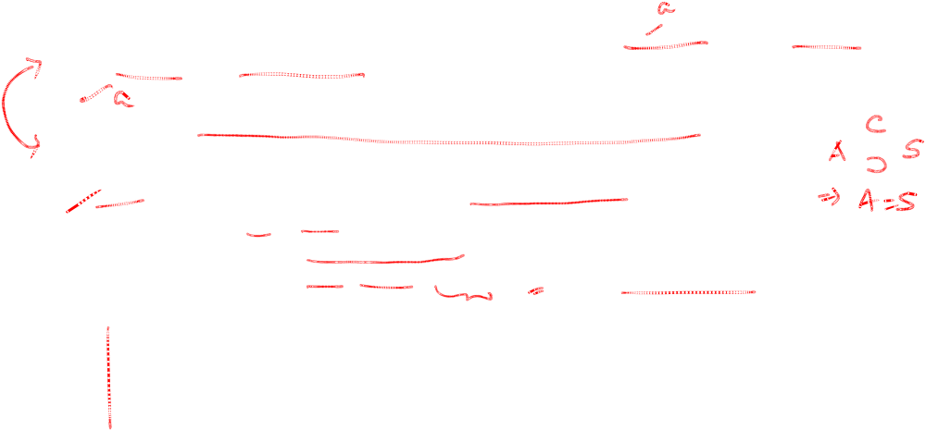
Induction and Recursively Defined Sets
Example: Show that the set S defined by specifying that 3 ∊ S and that if x ∊ S and y ∊ S, then x + y is in S, is the set of all positive integers that are multiples of 3.
Solution: Let A be the set of all positive integers divisible by 3. To prove that A = S, show that A is a subset of S and S is a subset of A.
  A⊂ S: Let P(n) be the statement that 3n belongs to S.
    BASIS STEP: 3∙1 = 3 ∊ S, by the first part of recursive definition.
    INDUCTIVE STEP: Assume P(k) is true. By the second part of the recursive definition, if 3k ∊ S, then since 3 ∊ S, 3k + 3 = 3(k + 1) ∊ S. Hence, P(k + 1) is true.
  S ⊂ A:
    BASIS STEP: 3 ∊ S by the first part of recursive definition, and 3 = 3∙1.
    INDUCTIVE STEP: The second part of the recursive definition adds x +y to S, if both x and y are in S. If x and y are both in A, then both x and y are divisible by 3. By part (i) of Theorem 1 of Section 4.1, it follows that x + y is divisible by 3.
We used mathematical induction to prove a result about a recursively defined set. Next we study a more direct form induction for proving results about recursively defined sets.

Slide 23
Structural Induction
Definition: To prove a property of the elements of a recursively defined set, we use structural induction.
  BASIS STEP: Show that the result holds for all elements specified in the basis step of the recursive definition.
  RECURSIVE STEP: Show that if the statement is true for each of the elements used to construct new elements in the recursive step of the definition, the result holds for these new elements.
The validity of structural induction can be shown to follow from the principle of mathematical induction.

Slide 24
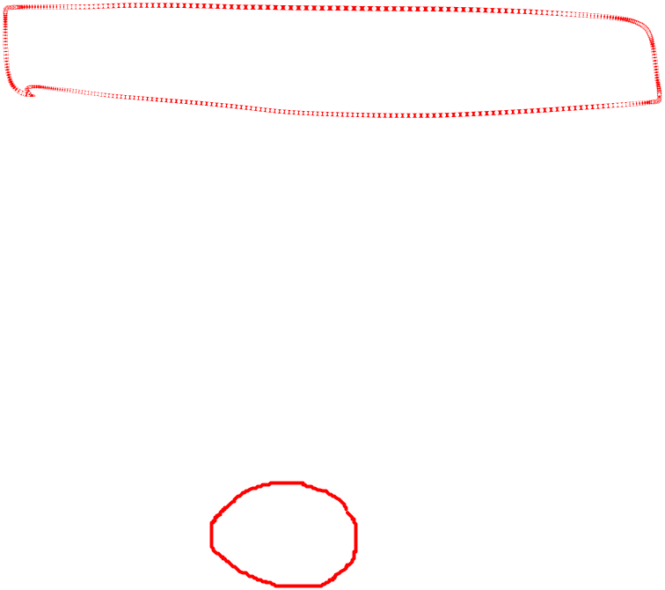
Full Binary Trees
Definition: The height h(T) of a full binary tree T is defined recursively as follows:
  BASIS STEP: The height of a full binary tree T consisting of only a root r is h(T) = 0.
  RECURSIVE STEP: If T₁ and T₂ are full binary trees, then the full binary tree T = T₁∙T₂ has height h(T) = 1 + max(h(T₁),h(T₂)).
The number of vertices n(T) of a full binary tree T satisfies the following recursive formula:
  BASIS STEP: The number of vertices of a full binary tree T consisting of only a root r is n(T) = 1.
  RECURSIVE STEP: If T₁ and T₂ are full binary trees, then the full binary tree T = T₁∙T₂ has the number of vertices n(T) = 1 + n(T₁) + n(T₂).

Slide 25
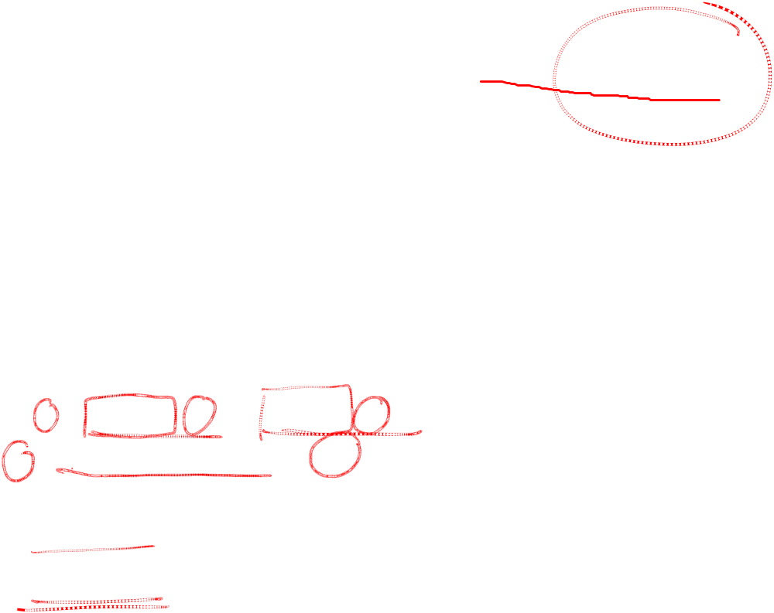
Structural Induction and Binary Trees
Theorem: If T is a full binary tree, then n(T) ≤ 2^{h(T)+1} – 1.
Proof: Use structural induction.
  BASIS STEP: The result holds for a full binary tree consisting only of a root, n(T) = 1 and h(T) = 0. Hence, n(T) = 1 ≤ 2⁰⁺¹ – 1 = 1.
  RECURSIVE STEP: Assume n(T₁) ≤ 2^{h(T1)+1} – 1 and also n(T₂) ≤ 2^{h(T2)+1} – 1 whenever T₁ and T₂ are full binary trees.
n(T) = 1 + n(T₁) + n(T₂) (by recursive formula of n(T))
≤ 1 + (2^{h(T1)+1} – 1) + (2^{h(T2)+1} – 1) (by inductive hypothesis)
≤ 2∙max(2^{h(T1)+1} ,2^{h(T2)+1} ) – 1
= 2∙2^{max(h(T1),h(T2))+1} – 1 (max(2^{x} , 2^{y})= 2^{max(x,y)} )
= 2∙2^{h(T)} – 1 (by recursive definition of h(T))
= 2^{h(T)+1} – 1

Slide 26
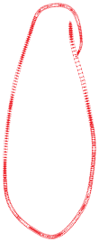



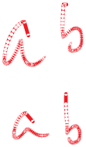



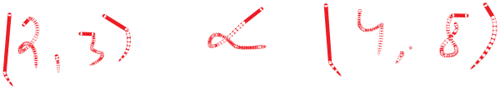
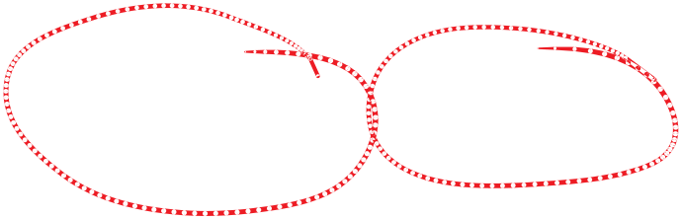
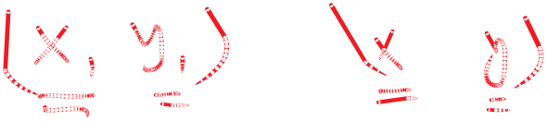
Generalized Induction
Generalized induction is used to prove results about sets other than the integers that have the well-ordering property.
For example, consider an ordering on N⨉ N, ordered pairs of nonnegative integers. Specify that (x₁ ,y₁) is less than or equal to (x₂,y₂) if either x₁ < x₂, or x₁ = x₂ and y₁ <y₂ . This is called the lexicographic ordering.
Strings are also commonly ordered by a lexicographic ordering.
The next example uses generalized induction to prove a result about ordered pairs from N⨉ N.

Slide 27
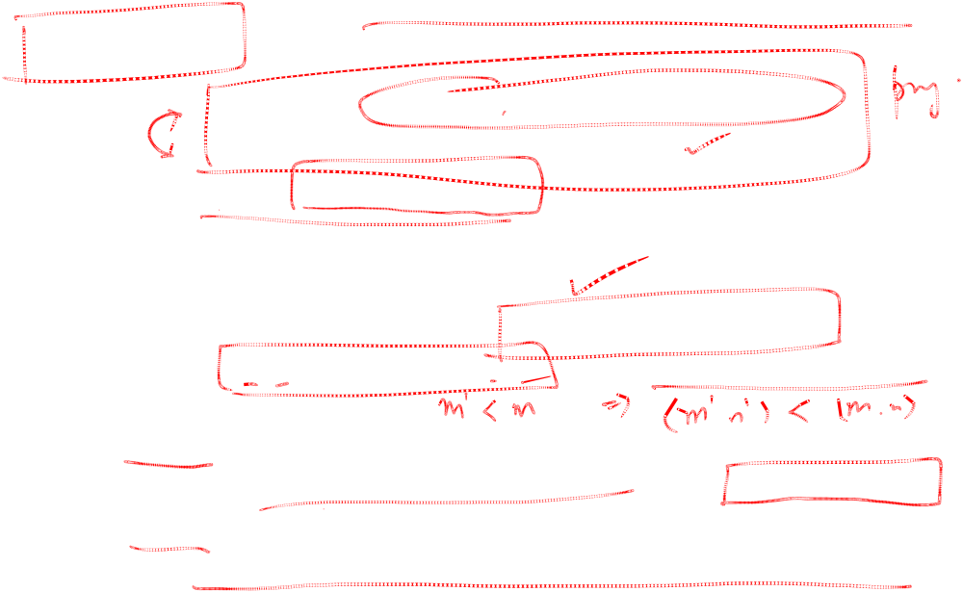
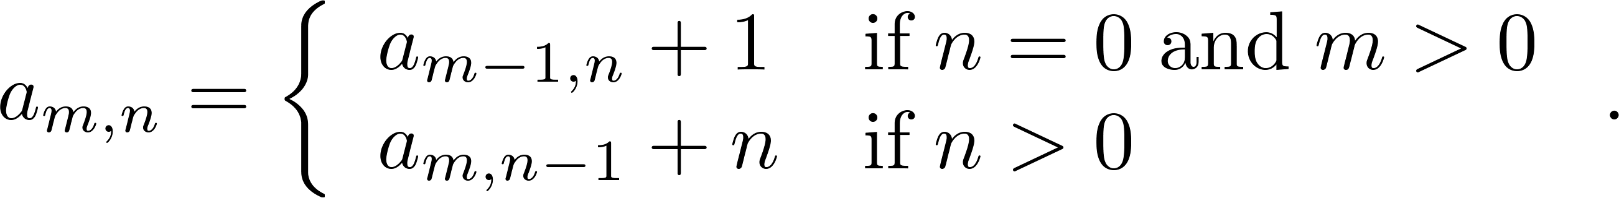
Generalized Induction
Example: Suppose that a_{m,n} is defined for (m,n)∊N ×N by a_{0,0} = 0 and
Show that a_{m,n} = m + n(n + 1)/2 is defined for all (m,n)∊N ×N.
Solution: Use generalized induction.
  BASIS STEP: a_{0,0} = 0 = 0 + (0∙1)/2
  INDUCTIVE STEP: Assume that a_{m̍,n̍} = m̍+ n̍(n̍ + 1)/2 whenever(m̍,n̍) is less than (m,n) in the lexicographic ordering of N ×N .
    If n = 0, by the inductive hypothesis we can conclude
    a_{m,n} = a_{m−1,n} + 1 = m − 1+ n(n + 1)/2 + 1 = m + n(n + 1)/2 .
    If n > 0, by the inductive hypothesis we can conclude
    a_{m,n} = a_{m,n-1} + n = m + n(n − 1)/2 +n = m + n(n + 1)/2 .

